Slide 1
WEST SIERRA VISTA PARTNERSHIP PROGRAM STATUS UPDATE
City Council Work Session
July 11, 2023

Slide 2
STRATEGIC PLAN SUPPORT
FY 15-17
“Develop, finance, and implement a program to incentivize West End commercial property improvements.”
FY 17-19
“Develop and implement a comprehensive strategy to promote infill and adaptive reuse of vacant commercial properties.”
FY 20-21
“Continue to provide incentives for West End redevelopment through the West SV Partnership Program.”
FY 22-23
“Expand the West End Redevelopment Area and the West Sierra Vista Partnership Program as appropriate.”
FY 24-25
“Continue to fund and promote the West Sierra Vista Partnership Program.”

Slide 3
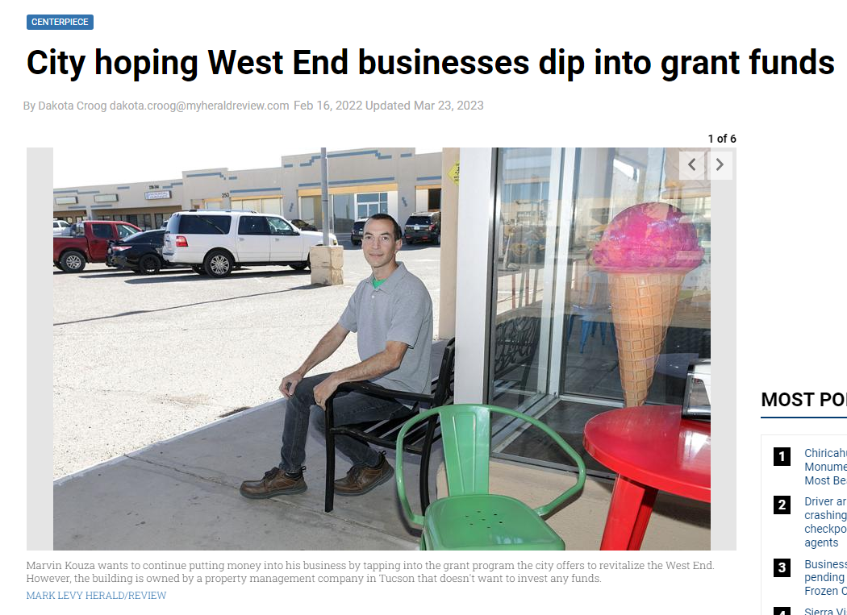
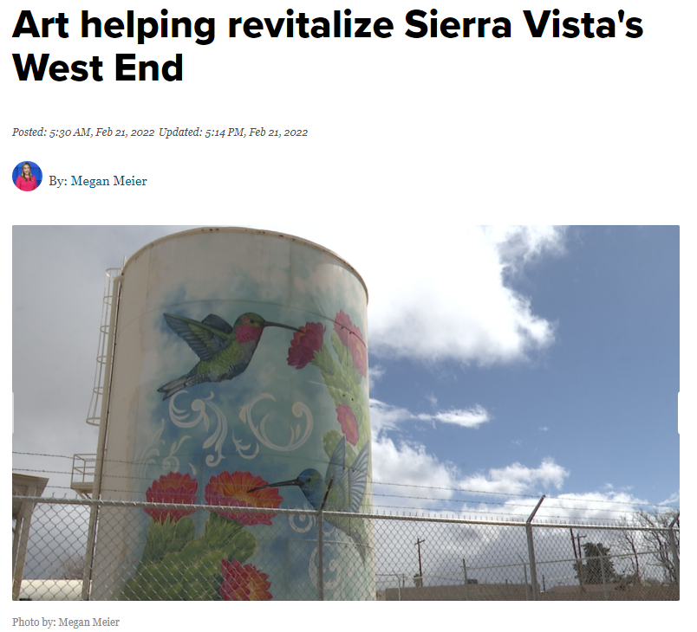
PROGRAM REQUIREMENTS
Program launched in 2018
Matching grant program on a reimbursement basis
Limited to properties inside redevelopment area
Non-profits that don’t generate sales tax are ineligible to apply
Funding is on a first come, first serve basis based on available budget
Projects should generally be completed within six months from grant being approved
One application per fiscal year

Slide 4
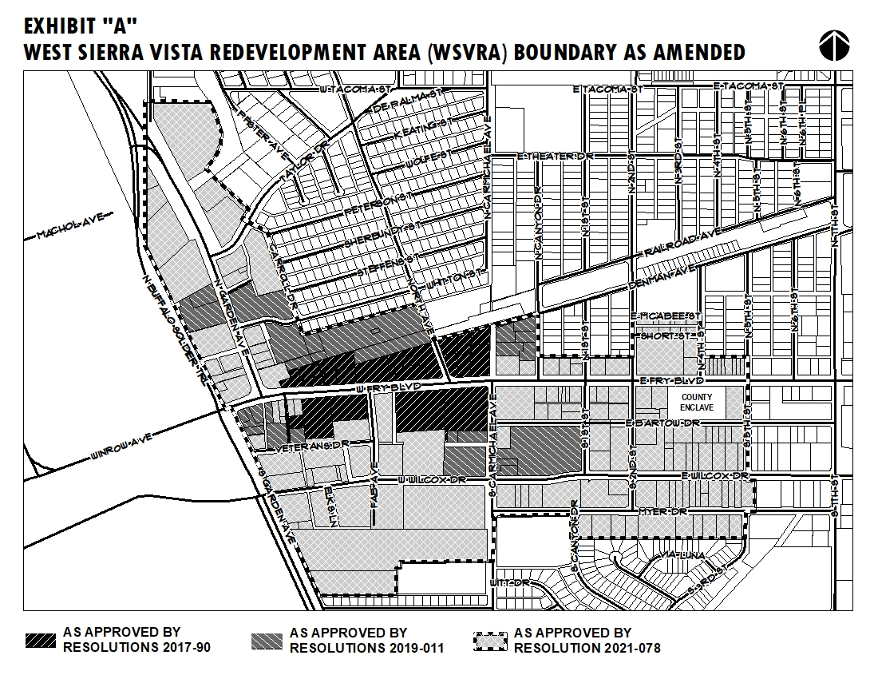

Slide 5
OBJECTIVES
REDUCE STOREFRONT VACANCIES TO INCREASE VITALITY AND GROW TAX BASE: Encourage entrepreneurs exploring opportunities in Sierra Vista to consider West End as a place to start business.
MAKE OLDER PROPERTIES MORE ACCESSIBLE AND READY FOR OCCUPANCY: To reduce initial startup costs associated with needed tenant improvements (signage, restroom/ADA modifications, fire suppression, plumbing, mechanical, electrical upgrades, site utilities, etc.)
ADD CURB APPEAL TO INCREASE VIBRANCY: To improve the look and feel of the district through demolition and site clearance, façade upgrades, landscaping, outdoor seating areas, public art, dumpster enclosures.

Slide 6
CATEGORIES OF ELIGIBLE WORK | MAXIMUM GRANT AWARD | MINIMUM PRIVATE MATCH REQUIRED BY APPLICANT
BUILDING FAÇADE RENOVATION GRANT | $15,000 | 50%
INTERIOR RENOVATION GRANT (FOR AREAS OPEN TO THE PUBLIC)
EATING /DRINKING ESTABLISHMENT/MICROBREWERY | $10,000 | 75%
RETAIL, OFFICE, SERVICE USE | $5,000 | 75%
PATIO DECK/OUTDOOR SEATING | $15,000 | 50%
SIGNAGE
NEW SIGNAGE | $2,500 | 50%
REPLACING EXISTING NON-CONFORMING SIGNAGE | $2,500 | 25%
ADA IMPROVEMENTS | $5,000 | 25%
PUBLIC ART/MURALS | $2,500 | 25%
LANDSCAPING | $2,000 | 25%
DUMPSTER ENCLOSURE | $2,500 | 50%
SITE UTILITIES | $25,000 | 50%
DEMOLITION/SITE CLEARANCE | $10,000 | 50%
OTHER | $5,000 | 50%

Slide 7
MAXIMUM GRANT AWARD
The maximum grant award shall not exceed $25,000 per property, provided, however, the City may exceed this amount for projects that result in one or more of the following:
The creation of ten or more new full time equivalent jobs;
A new business that is projected to generate city sales tax exceeding the requested grant amount within five years;
New construction value exceeding $1,000,000 on historically vacant, underused, or blighted property.*
*Subject to funding available during the fiscal year the project will be completed.

Slide 8
PROGRAM HISTORY
YEAR APPROVED | APPLICATIONS APPROVED | PUBLIC INVESTMENT (GRANT AMOUNT) | PRIVATE INVESTMENT (MATCH) | PRIVATE TO PUBLIC INVESTMENT RATIO
2018 | 3 | $19,805 | $25,804 | 1.3:1
2019 | 4 | $76,184 | $335,392 | 4.4:1
2020 | 5 | $40,167 | $108,871 | 2.7:1
2021 | 2 | $10,389 | $16,412 | 1.6:1
2022 | 5 | $43,983 | $1,256,510 | 28.6:1
2023 | 12 | $123,172 | $2,724,834 | 22.1:1
TOTAL | 31 | $313,701 | $4,467,823.72 | 14.2:1
MEDIAN GRANT AWARD IS $5,000

Slide 9
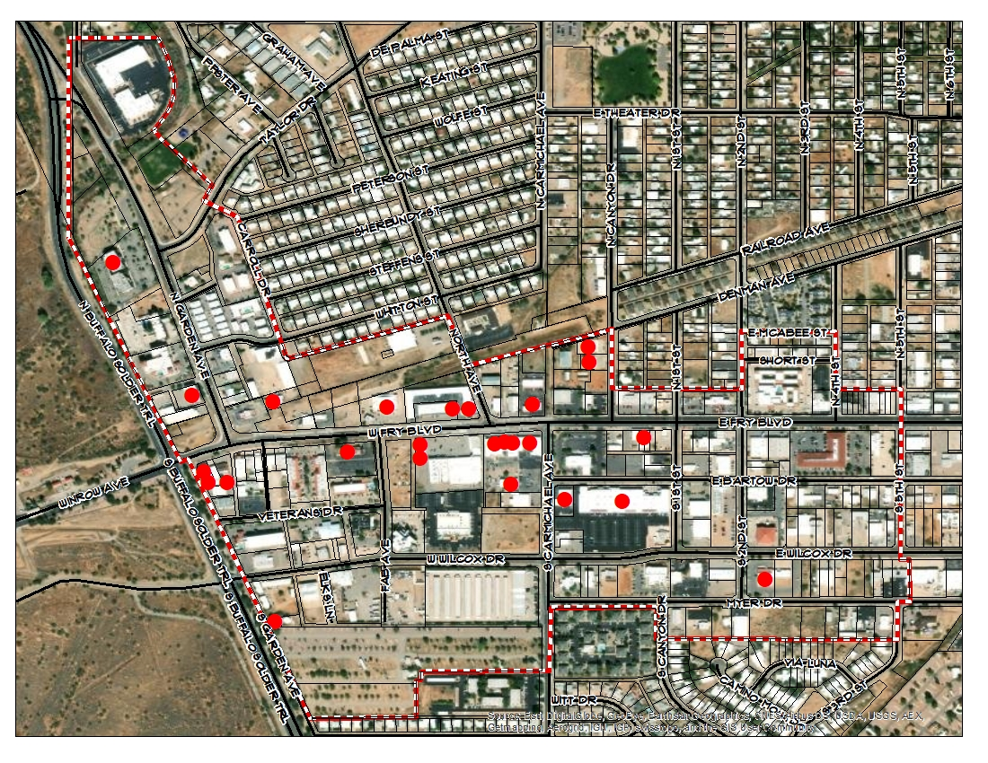
GEOGRAPHIC DISTRIBUTION

Slide 10
PROJECTS COMPLETED IN FY 23
FISCAL YEAR | BUSINESS | LOCATION | CITY | PRIVATE | CATEGORY | TYPE
2022 (CARRYOVER) | COCHISE DENTAL | 66 N GARDEN AVE | $7,500.00 | $1,180,395.00 | EXTERIOR, LANDSCAPE, ADA, INTERIOR, SIGNAGE | RELOCATION/ EXPANSION
2022 (CARRYOVER) | TOMBSTONE BREWERY | 332 N GARDEN AVENUE | $20,000.00 | $2,381,790.00 | OUTDOOR SEATING AREA, DUMPSTER ENCLOSURE; NEW CONSTRUCTION | NEW BUSINESS
2022 (CARRYOVER) | WEST END HEALTH CENTER | 125 S. 2ND STREET | $1,250.00 | $1,250.00 | MURALS | RELOCATION/ EXPANSION
2023 | MP LLC/AITC | 502 N GARDEN AVE | $16,375.00 | $28,382.67 | BUILDING FAÇADE | NEW BUSINESS
2023 | WE FRAME IT | 590 E FRY BLVD | $2,887.50 | $2,887.50 | ADA RAMPS | UPGRADE TO EXISTING BUSINESS
2023 | WEST END REALTY | 301 S GARDEN AVE | $2,500.00 | $2,500.00 | SIGNAGE | NEW BUSINESS
2023 | SIERRA VISTA DANCE CO | 156 W FRY BLVD | $1,645.20 | $1,645.20 | SIGNAGE | NEW BUSINESS
2023 | JUAN'S BARBERSHOP | 11 E WILCOX | $5,700.00 | $12,450.00 | INTERIOR RENOVATION, SIGNAGE, FEE WAIVER | EXPANSION TO EXISTING BUSINESS
2023 | COCHISE DENTAL | 66 N GARDEN AVE | $2,500.00 | $7,500.00 | PUBLIC ART (SCULPTURE) | UPGRADE TO EXISTING BUSINESS
2023 | LAUS DEO FIDELITY | 33/51 S GARDEN AVE | $5,000.00 | $17,000.00 | FAÇADE RENOVATION | UPGRADE TO EXISTING BUSINESS
2023 | HIGH DESERT | 445 WHITTON | $13,015.44 | $14,421.81 | ADA/SITE UTILITIES | RELOCATION/ EXPANSION
TOTAL |  |  | $78,373.14 | $3,650,222.18 | 46.6:1 PRIVATE TO PUBLIC MATCH

Slide 11
PROJECTS INIITATED/PARTIALLY COMPLETED
FISCAL YEAR | BUSINESS | LOCATION | CITY | PRIVATE | CATEGORY | TYPE | STATUS
2022 (CARRYOVER) | WEST END HEALTH CENTER | 125 S 2ND ST | $5,087.50 | $5,087.50 | SIGNAGE, AWNINGS | RELOCATION/ EXPANSION | PARTIALLY COMPLETE (MONUMENT SIGN REMAINING - EST COMPLETION 7/31/23)
2023 | TELL MAMMA | 325 W FRY BLVD STE G | $21,430.55 | $130,500.00 | DEMO; INTERIOR RENOVATION; SIGNAGE; OTHER; FEES | NEW BUSINESS | UNDERWAY; ANTICIPATED TO BE COMPLETE BY 7/31/23
2023 | GYFTED CREATIONS LLC | 209 W FRY BLVD | $10,518.69 | $29,669.57 | INTERIOR RENO/ SIGNAGE | NEW BUSINESS | IN PERMITTING
2023 | HIGH DESERT | 445 WHITTON ST. | $6,600 | $6,600 | SIGN, BUILDING FAÇADE | RELOCATION/ EXPANSION | UNDERWAY
2023 | SNS BUILDING | 148 E FRY BLVD. | $15,000.00 | $24,200.00 | FAÇADE RENOVATION | UPGRADE | UNDERWAY
TOTAL |  |  | $58,636.74 | $196,057.07 | 3.3:1 PRIVATE TO PUBLIC MATCH

Slide 12
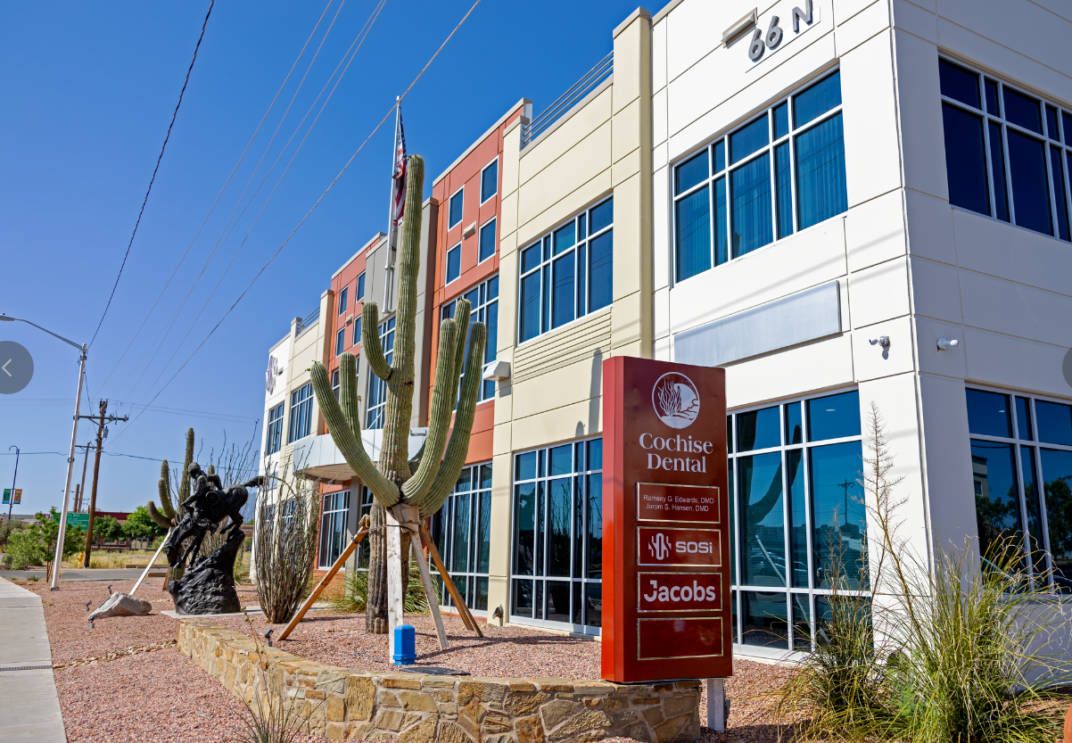

Slide 13
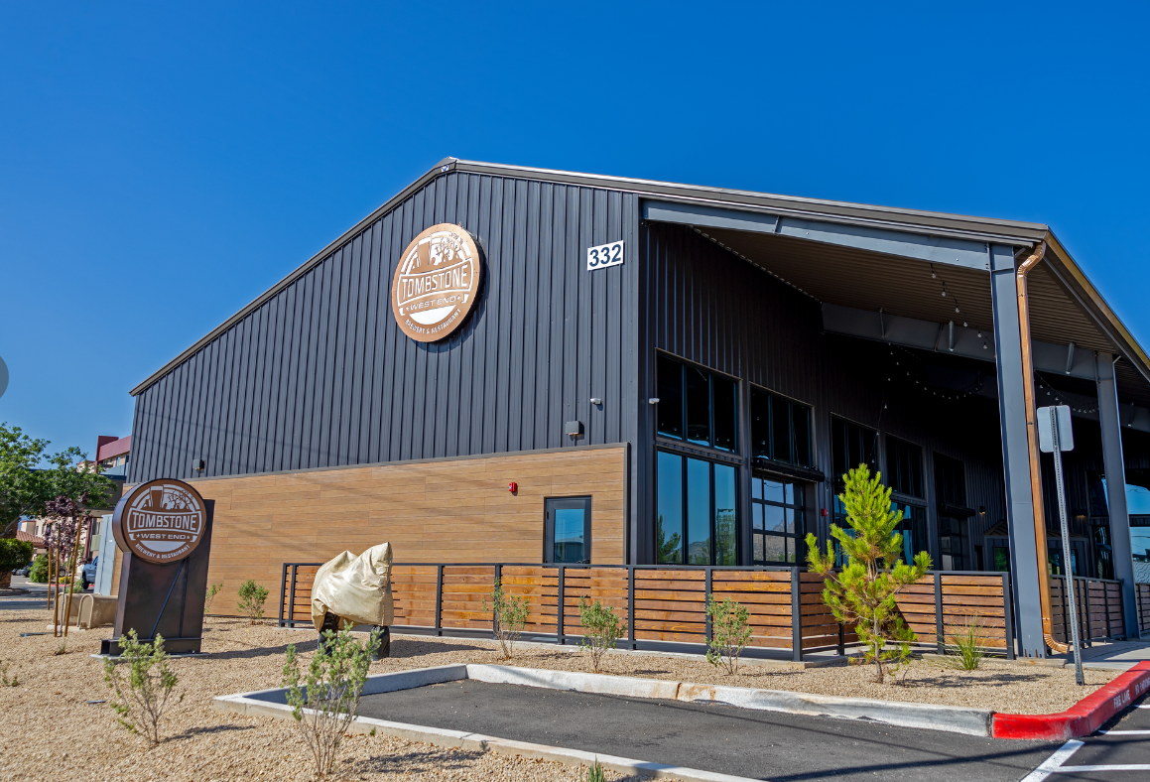

Slide 14
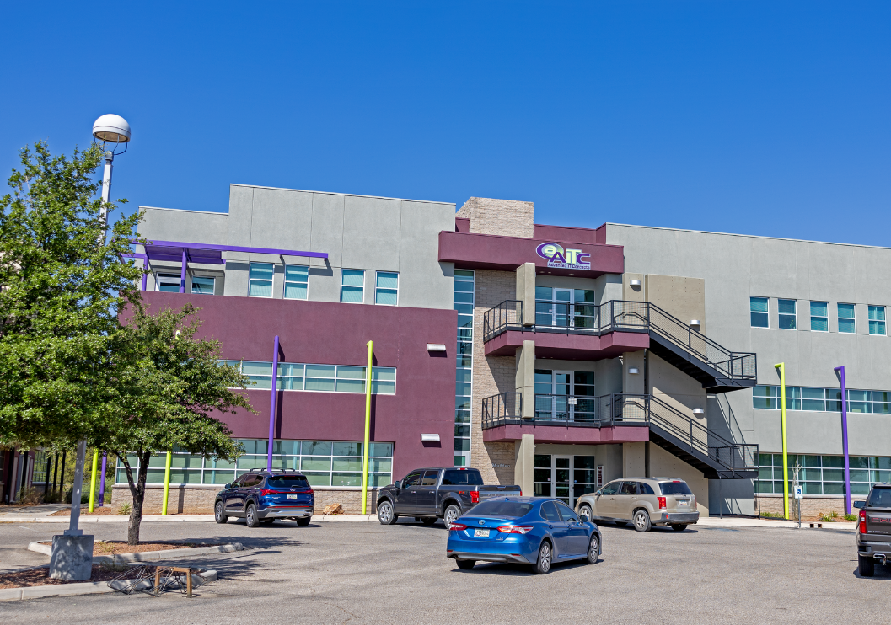

Slide 15
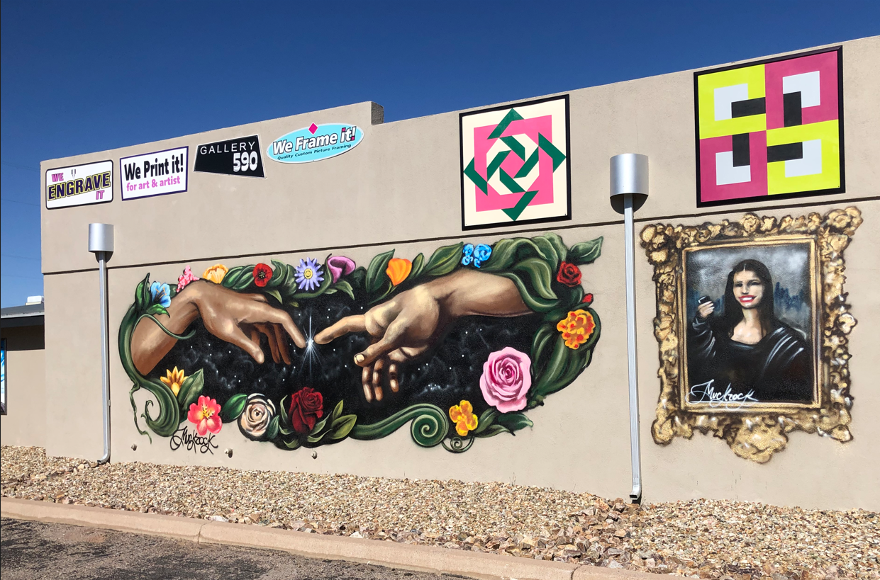

Slide 16
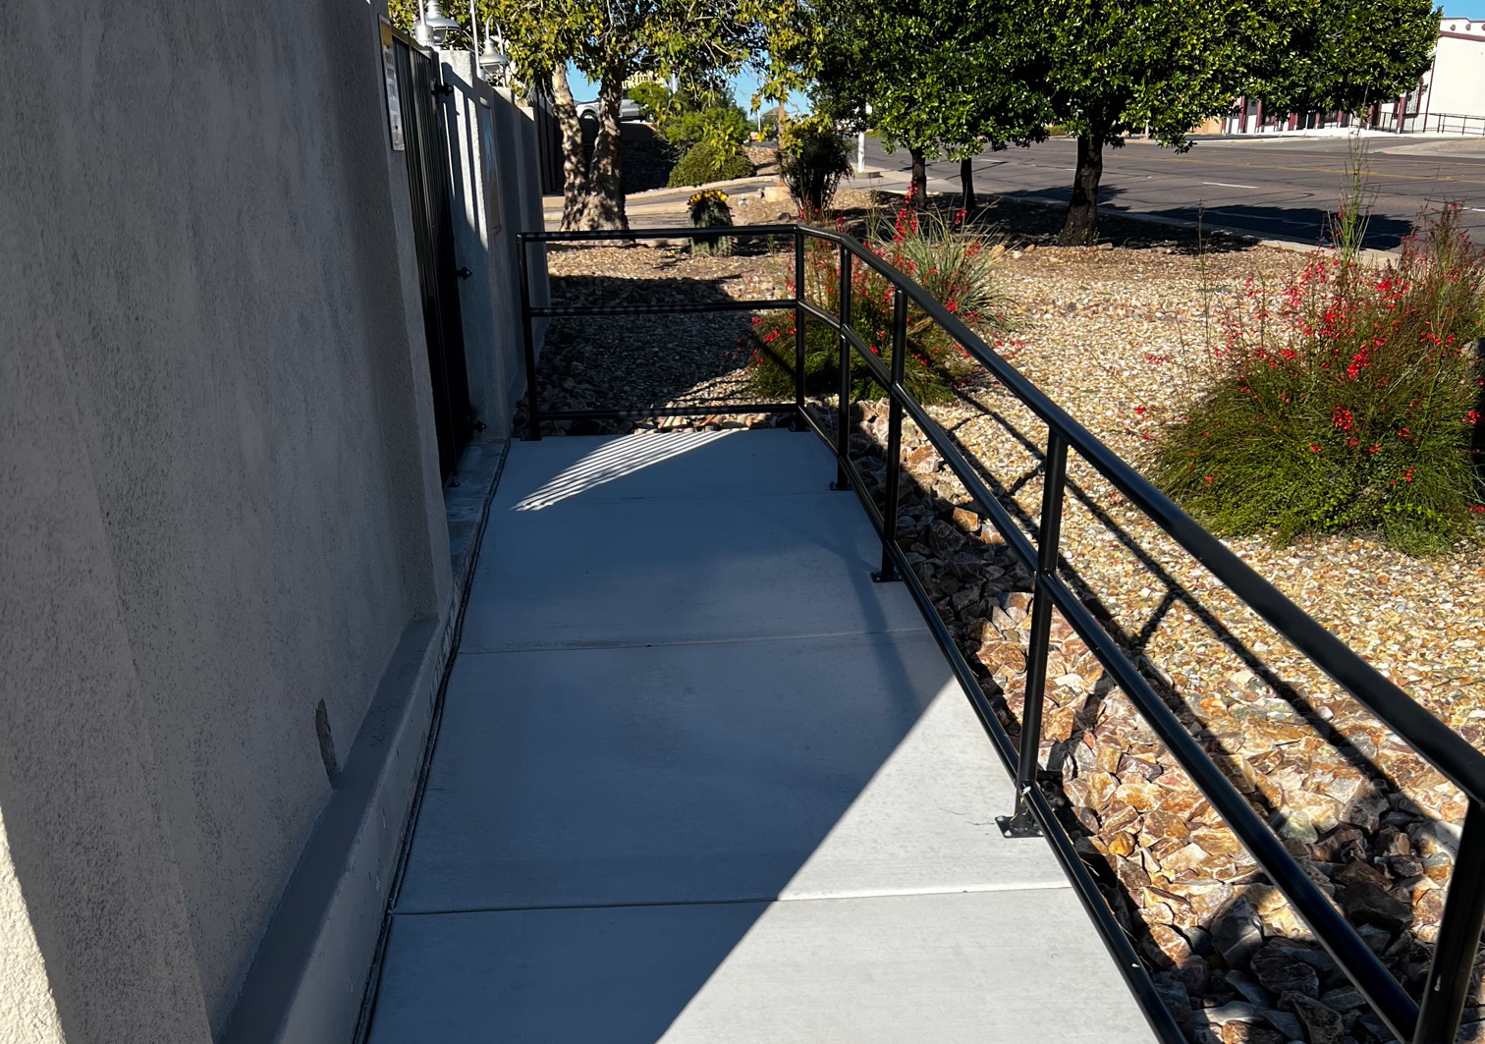

Slide 17
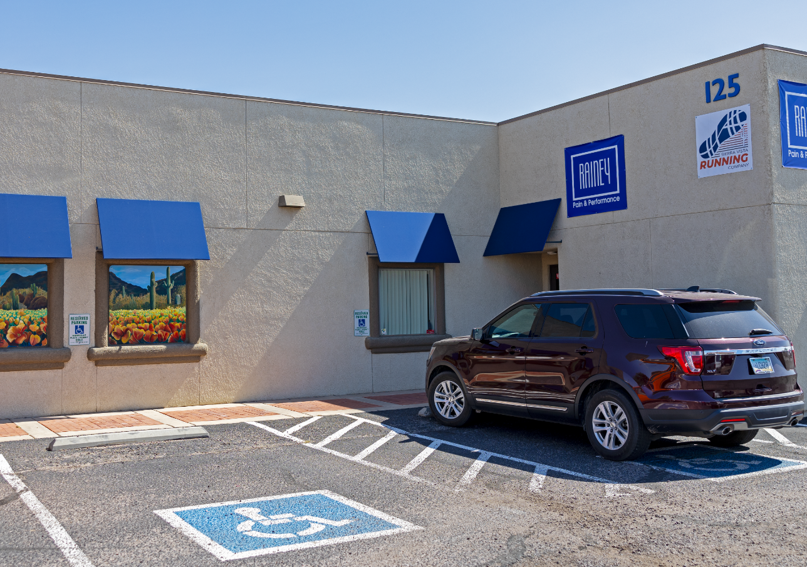

Slide 18
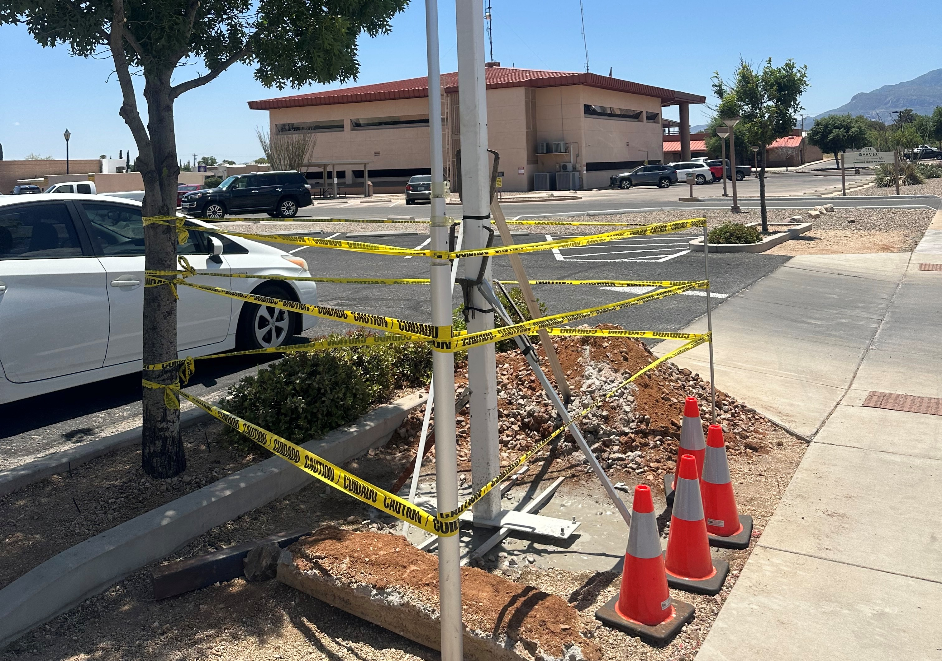

Slide 19
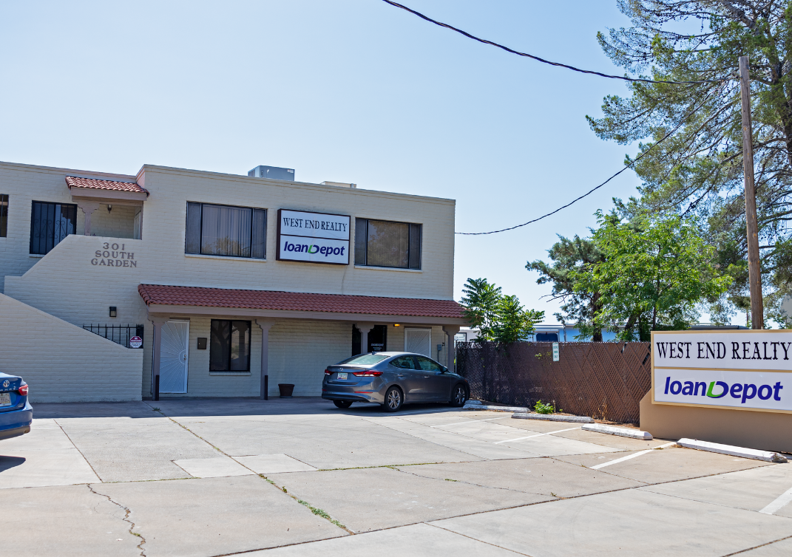

Slide 20
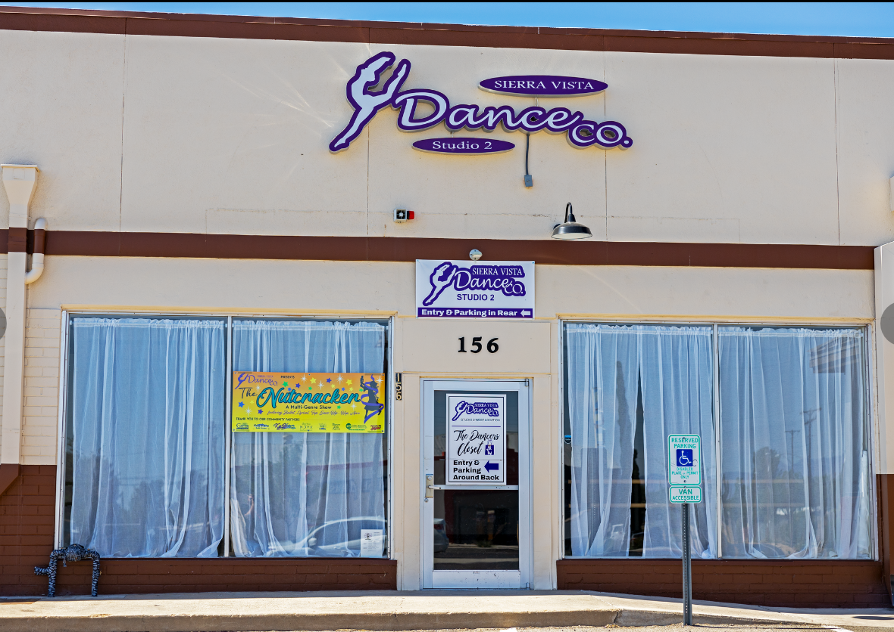

Slide 21
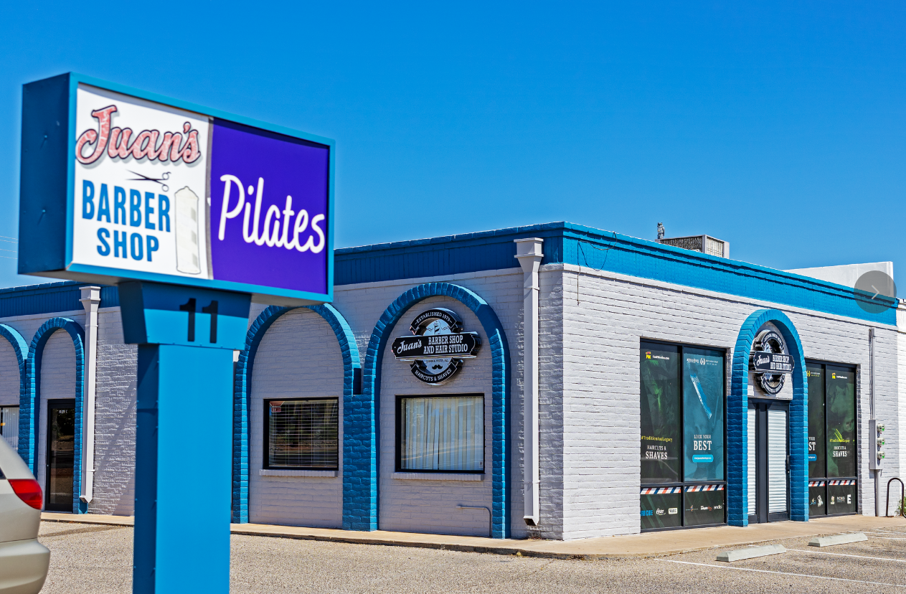

Slide 22
