Slide 1
FAB AVENUE PROPERTY
POSSIBLE SITE REUSE ALTERNATIVES
FAB AVENUE PROPERTY
City Council Work Session
March 21, 2023
URBAN FRAMEWORK PLAN WITH CATALYST SITES
WEST SIERRA VISTA REDEVELOPMENT AREA PLAN

Slide 2
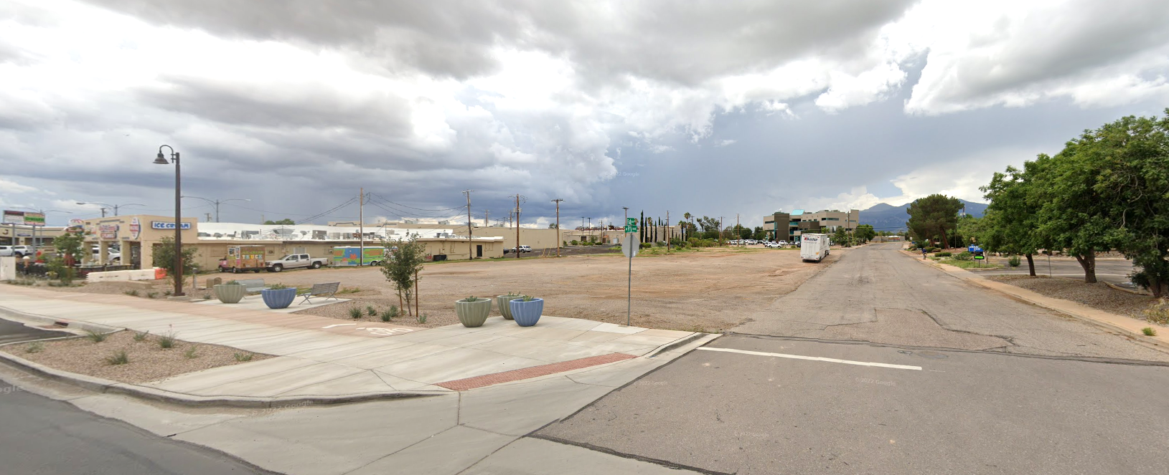
Background
1.34-Acre Site on Southeast Corner of W Fry Blvd/Fab Ave
Acquired by City in October 2020
Currently planned and zoned for commercial use
Related Strategic Plan Initiative: “Plan for the future use of the Fab Avenue property and implement improvements”.

Slide 3
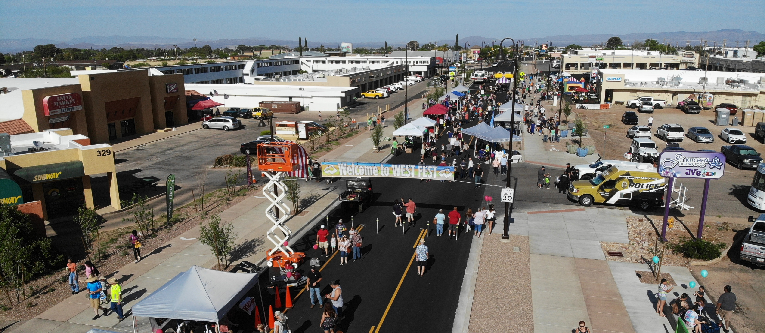
Seeking City Council feedback and direction on:
Project objectives
Desired uses for the site (Phase 3 subarea in particular)
Approach and phasing

Slide 4
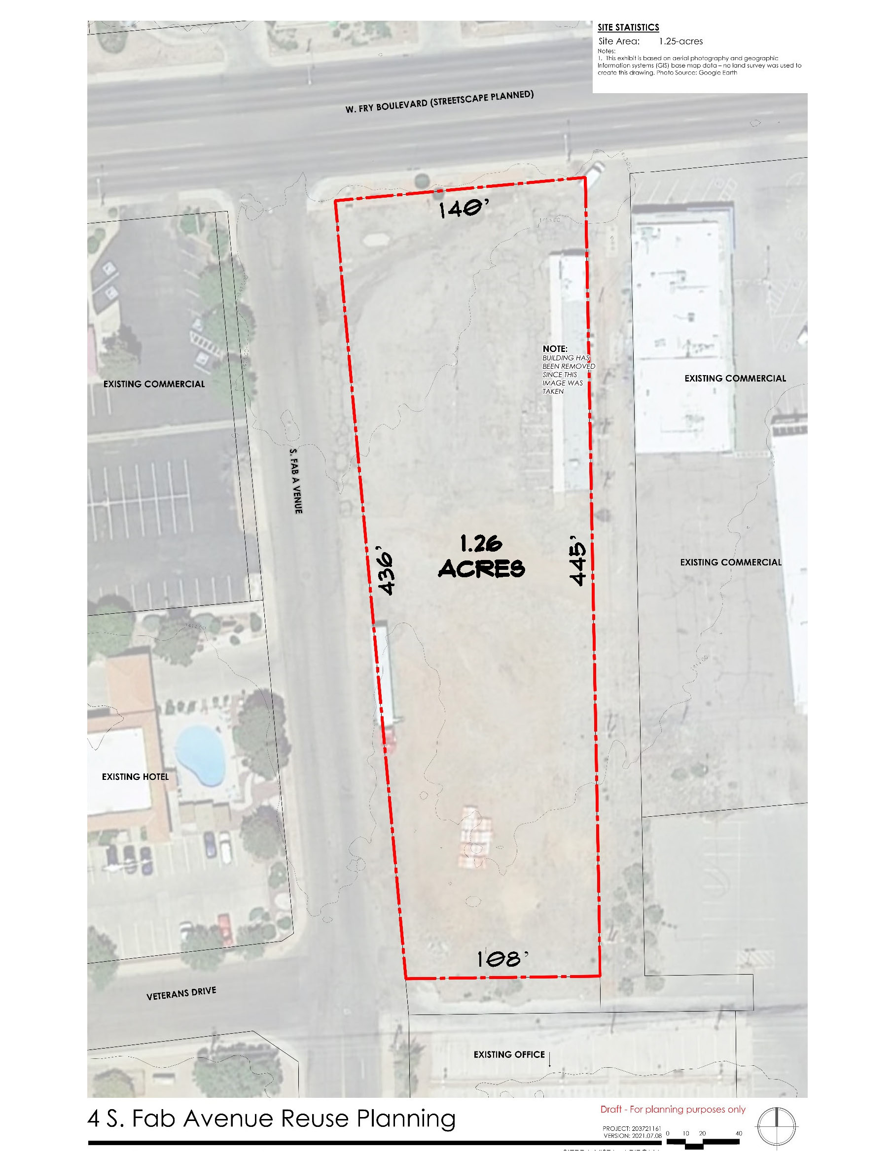
Overarching Objectives:
Resolve ponding issues
Add public parking
Create vibrant and attractive space(s) that will serve as a key focal point for the West End and ties in with the streetscape
Develop uses and activities that will draw people to the West End including potential public/private partnerships

Slide 5
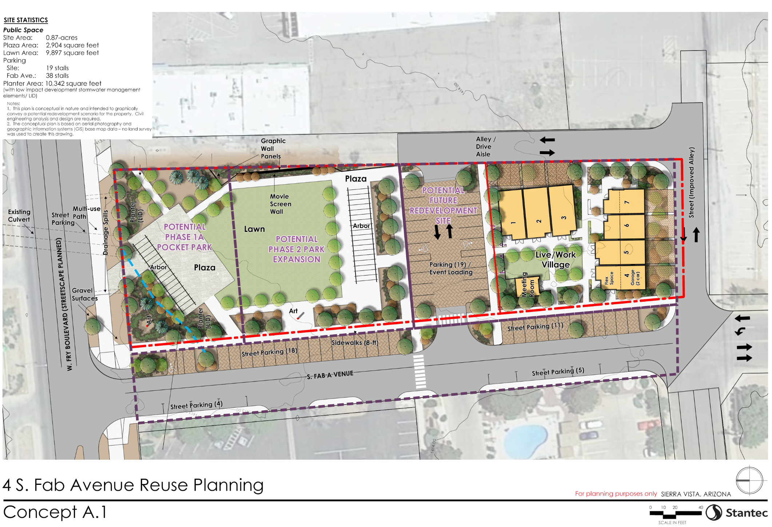
PUBLIC/PRIVATE USE OPTION

Slide 6
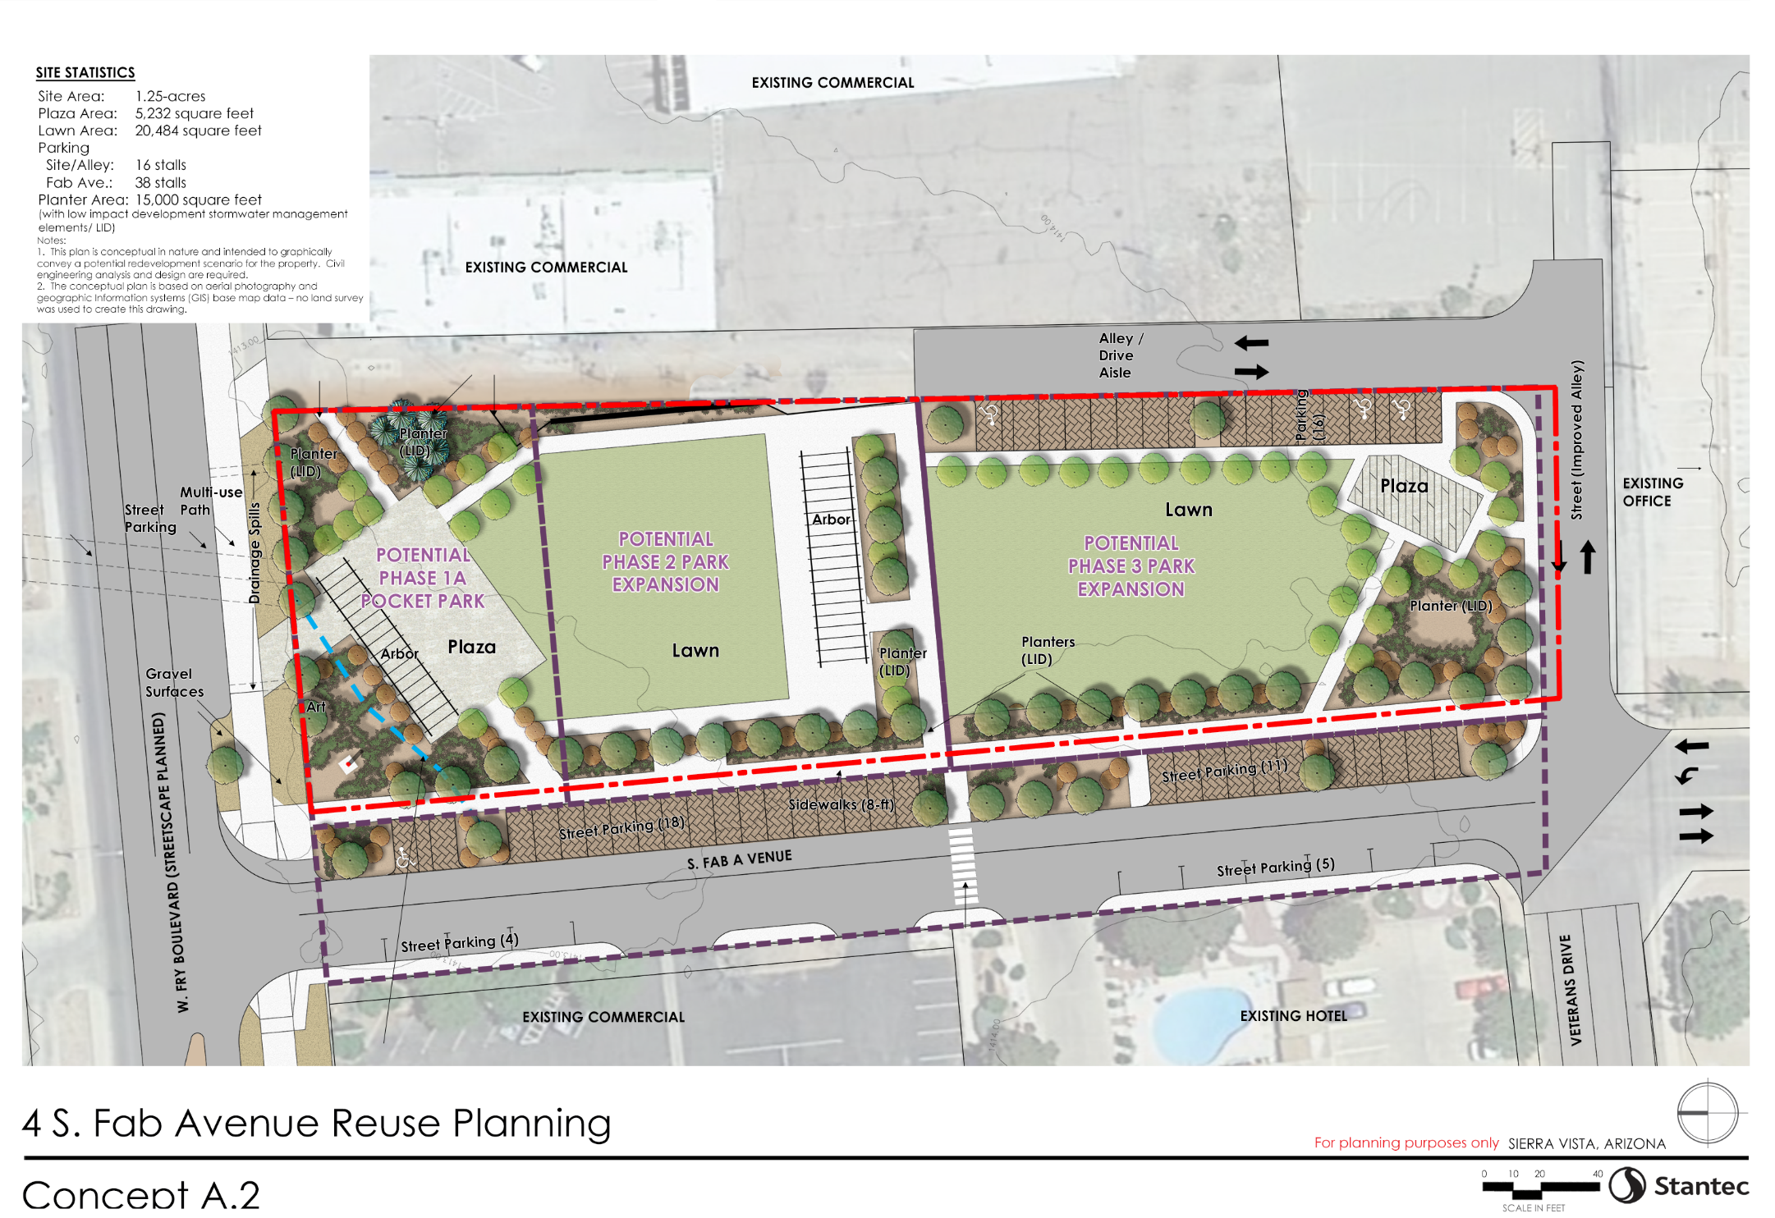
PUBLIC USE OPTION

Slide 7
PUBLIC FEEDBACK – FAB/FRY PROPERTY REUSE OPTIONS
Went live on Engage Sierra Vista on February 23, 2022. Pushed out thru the City’s weekly newsletter and on social media.
32 comments from 29 unique commenters
84% of those taking the poll favor Concept A2 (public option)

Slide 8
PUBLIC FEEDBACK – FAB AVENUE PROPERTY REUSE OPTIONS
INPUT SUMMARY:
Add more off-street parking
Incorporate movie and artistic walls in both A.1 and A.2 (prefer A.2).
Add terraced seating to plaza to act as music and event venue (see Heritage Square in Flagstaff)
Hold more events, festivals, live music
Splash park for kids using recycled water.
Interactive play equipment/climbing/encourage child movement
Use existing empty building stock for Live/Work spaces

Slide 9
PUBLIC FEEDBACK – FAB AVENUE PROPERTY REUSE OPTIONS
INPUT SUMMARY (CONT’D):
Encourage more outdoor seating close to businesses.
Need more than buildings on West End – Add park/greenspace
Need more color/art
Reduce live work concept and make buildings places for the community such as small library, community classrooms, police substation.
Add restrooms and benches
Make sure there are trash receptacles and hydration stations
Install pull-ups and hook-ups for food trucks.
Install EV chargers/spaces along Fab Ave

Slide 10
CONCEPTUAL CONSTRUCTION ESTIMATE
PREPARED BY STANTEC, INC. (FEBRUARY 22)
Phase 1A: Pocket Park …………………………………..$843,400
Phase 1B: Fab Avenue R/W Enhancements………….$358,800*
Phase 2: Park Expansion……………………………...$1,234,800
Total Overall Project Cost Estimate…………………...$2,463,791
*The City was awarded a $365,424 grant from the Federal Transit Administration for street improvements to Fab Avenue R/W.

Slide 11
RECOMMENDED PHASING
Amend future land use and zoning designation on property to reflect desired uses.
Amend Parks and Recreation Master Plan to show portion of property to be set aside as a park/public facility and include in 10-Year Capital Improvement Program
Design and construct street and drainage improvements using FTA Grant and any other available funding sources
Prepare design and construction plans for on-site public improvements starting north to south to make the project “shovel ready” to elevate its potential for outside grant funding.
Continue citizen/City Commission(s) involvement on defining thematic features/elements

