Slide 1
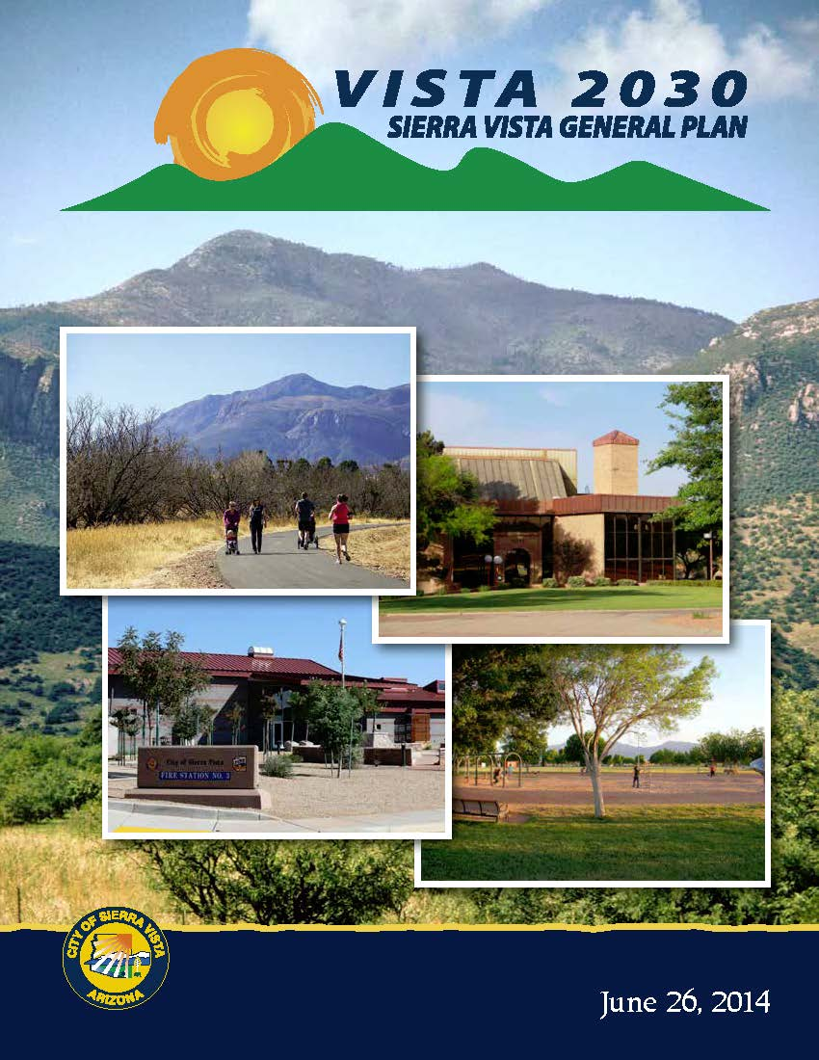
GENERAL PLAN UPDATE
Mayor and City Council

Slide 2
WHAT IS A GENERAL PLAN
The General Plan is an expression of community vision, aspirations, values and goals. It is a short- and long-term decision-making guide to achieve the vision, and it fulfills State legal requirements.

Slide 3
WHAT IS A GENERAL PLAN
The General Plan is a broad, flexible document that changes as community needs, conditions, and directions change. It can be revised through City-initiated amendments, citizen/property owner requests, or through referenda. Ultimately, the decision to amend is in the hands of the City Council.

Slide 4
GENERAL PLAN STATE STATUTES
[A.R.S] 9-461.05(A)-Each planning agency shall prepare, and the governing body of each municipality shall adopt, a comprehensive, long-range general plan for the development of the municipality.
[A.R.S.] 9-461.06(K)-A general plan, with any amendments, is effective for up to ten years from the date the plan was initially adopted and ratified;

Slide 5
GENERAL PLAN STATE STATUTES
[A.R.S.] 9-461.06(K) On or before the tenth anniversary of the plan's most recent adoption, the governing body of the municipality shall either readopt the existing plan for an additional term of up to ten years or shall adopt a new general plan as provided by this article.
[A.R.S.] 9-461.06(M)- The governing body of any city or town having a population of ten thousand or more persons, shall submit each new general plan adopted to the voters for ratification.

Slide 6
GENERAL PLAN STATE MANDATED ELEMENTS
[A.R.S.] 9-461.05(C) The General Plan shall consist of community goals and development policies and include the following elements:
Land Use
Circulation Element
Open Space
Growth Element
Environmental Planning
Cost of Development
Water Resources

Slide 7
GENERAL PLAN STATE MANDATED ELEMENTS
[A.R.S.] 9-461.05(C) For cities with a population under 50,000 persons, the General Plan may include the following elements:
Conservation
Recreation
Public Service and Facilities
Public Buildings
Housing
Redevelopment

Slide 8
GENERAL PLAN STATE MANDATED ELEMENTS
[A.R.S.] 9-461.05(C) For cities with a population under 50,000 persons, the General Plan may include the following elements:
Safety
Bicycling
Energy Element
Neighborhood Preservation
Other elements based on community feedback
VISTA 2030 includes both the mandatory and the optional elements

Slide 9
SIERRA VISTA GENERAL PLAN
On June 26, 2014, the City Council adopted VISTA 2030, replacing the previously approved General Plan called VISTA 2020.
On November 4, 2014, the citizens of Sierra Vista ratified VISTA 2030.
The next General Plan needs to be ratified in November 2024.

Slide 10
EVALUATION AND APPRAISAL REPORT
WHAT IS AN EAR?
A review of the adopted General Plan to determine how well the City is meeting the Elements, Goals, and Objectives as set forth in the General Plan, including what issues need to be addressed to meet expectations and what tools could be used to address the issues raised in the community.

Slide 11
EVALUATION AND APPRAISAL REPORT
Staff analyzed each Element in the General Plan and provided an evaluation of each Strategy and Goal.
This evaluation was presented to the Planning & Zoning Commission at various work sessions in 2020 and 2021.
The City Council has been provided with staff’s written background information of each General Plan Element’s Strategies and Goals.

Slide 12
EVALUATION AND APPRAISAL REPORT
GROWTH AND LAND USE
RESIDENTIAL
5,000 acres developed;
23,000 acres undeveloped (State Land, Tribute);
378 undeveloped residential parcels;
13,854 developed residential parcels;
445 new single family residential homes constructed since 2015.

Slide 13
EVALUATION AND APPRAISAL REPORT
GROWTH AND LAND USE
COMMERCIAL
670 acres developed;
760 acres undeveloped;
378 undeveloped commercial parcels;
492 developed commercial parcels;
15 new commercial properties constructed since 2015.

Slide 14
EVALUATION AND APPRAISAL REPORT
GROWTH AND LAND USE
INDUSTRIAL
110 acres developed;
283 acres undeveloped (Ft. Huachuca 200 acres);
48 undeveloped industrial parcels;
32 developed industrial parcels;
1 new industrial parcel constructed since 2015.

Slide 15
EVALUATION AND APPRAISAL REPORT
REDEVELOPMENT/NEIGHBORHOOD ENHANCEMENT
2017-Adoption of West Sierra Vista Redevelopment Area/Partnership Program. Provides grant opportunities for building and site improvements.
2015-2021-Infrastructure Upgrades/Improvements Walkability, connectivity, safety, drainage improvements, and landscaping.
2020-Update to the Urban Infill Incentive District Policy Provides fee and development reductions/waivers.

Slide 16
EVALUATION AND APPRAISAL REPORT
AFFORDABLE HOUSING
Eight affordable housing developments. Three more potential developments.
Development fees waived, site plan review and processing fees reduced by 50 percent.
Developments within Infill Incentive District can request a waiver or reduction in fees (building plan and permit) which meet certain criteria.

Slide 17
EVALUATION AND APPRAISAL REPORT
AFFORDABLE HOUSING
Code amendment allowing apartments within General Commercial (GC) zoning districts. Allows for hotel/motel conversions to apartments.
Code amendment allowing Accessory Dwelling Units in Single Family Residential (SFR) Zoning Districts provided certain development standards met. A form of affordable housing.
Emergency Home Repair and Disabilities Modification Program. Provides funding to make repairs to substandard housing and accessibility modifications for disabled homeowners.

Slide 18
EVALUATION AND APPRAISAL REPORT
AFFORDABLE HOUSING
City supports organizations such as the Good Neighbor Alliance through the CDBG program to help with site and building improvements.
City supports the Cochise College residential construction program by waiving the sewer connection fees.
National Fair Housing Month recognized every April through a City Council proclamation.

Slide 19
EVALUATION AND APPRAISAL REPORT
TRANSPORTATION CONNECTIONS AND ENHANCEMENTS
Safe Bicycle and Pedestrian Routes Plan prioritizes multi-modal projects (2011). Multi-modal projects are completed per this Plan. These projects included in the Metropolitan Planning Organization (MPO) Long Range Transportation Plan.

Slide 20
EVALUATION AND APPRAISAL REPORT
TRANSPORTATION CONNECTIONS AND ENHANCEMENTS
CONNECTIVITY/ENHANCEMENT PROJECTS:
Multi-use path on west side of State Route 92 from Foothills Dr. to Avenida Cochise.
Multi-Use path on east side of Buffalo Soldier Trail from Golf Links Rd. to Fry Blvd.
West Fry Blvd./N. Garden Ave project, multi-modal project.

Slide 21
EVALUATION AND APPRAISAL REPORT
TRANSPORTATION CONNECTIONS AND ENHANCEMENTS
Current subdivisions that have provided multi-use pathways that connect to pedestrian ways and washes include Summit Heights, Canada Vista, The Retreat and Holiday. The Tribute Specific Plan proposes similar multi-use path connectivity.

Slide 22
EVALUATION AND APPRAISAL REPORT
TRANSPORTATION CONNECTIONS AND ENHANCEMENTS
In 2019, seven additional bus stops added to the bus routes to better serve the community.
The Short-Range Transit Plan was adopted in August of 2021.

Slide 23
EVALUATION AND APPRAISAL REPORT
URBAN DESIGN
Electronic Message Signs/Outdoor Lighting Code-2015
Bicycle Parking Code Amendment in 2017 which required bicycle racks for newly constructed commercial buildings.
Architectural Design Standards-2019

Slide 24
EVALUATION AND APPRAISAL REPORT
ENVIRONMENTAL & SUSTAINABILITY
City provides funds to the Water Wise Program which offers water conservation services;
Approved water harvesting standards, continue to enforce water conservation measures; Water usage reduced from 7,633 acre feet in 2000 to 6,814 acre feet in 2020.
City implements the Toilet Rebate Program.

Slide 25
EVALUATION AND APPRAISAL REPORT
ENVIRONMENTAL & SUSTAINABILITY
City is a founding member of the Cochise Conservation and Recharge Network which implement and designs projects designed to increase groundwater recharge and protect groundwater resources.
Wash and Drainageway Maintenance Policy was amended to include language about wildlife habitat protection.

Slide 26
EVALUATION AND APPRAISAL REPORT
ENVIRONMENTAL & SUSTAINABILITY
Schneider Electric Project replaced light bulbs at all City facilities, buildings, parks, and fields to high efficient LED bulbs. Soccer fields constructed or replaced with artificial turf. Saved both energy and water.
Adopt-A-Area program is a stewardship program where the public can maintain and clean washes, streets, parks, and events.

Slide 27
EVALUATION AND APPRAISAL REPORT
PARKS, FACILITIES, AND SERVICES
Parkland Level of Service Standard-10 acres of parkland per 1,000 residents which totals 440 acres. The acquisition of new park land, Rothery, Roadrunner, and eventually Tribute Parks will meet this standard.
New Parks Master Plan approved on August 12, 2021. This plan addresses parks improvements, amenities and programs. Will be included as a new appendix to General Plan.

Slide 28
EVALUATION AND APPRAISAL REPORT
PARKS, FACILITIES, AND SERVICES
EMS substation approved in 2021 to provide quicker response times.
Southeast Arizona Communications Facility (SEACOM) started in 2017 and is a regional hub for 9-1-1 dispatching and emergency services coordination.
Public Library has additional audio books and online services which has increased their ability to serve more citizens especially during the pandemic.

Slide 29
GENERAL PLAN UPDATE ORGANIZATION AND FORMAT
Vision
Visioning is a critical step in articulating the shared values of Sierra Vista residents, business owners, and community leaders. (Outstanding Livability, Exceptional Experience)

Slide 30
GENERAL PLAN UPDATE ORGANIZATION AND FORMAT
Values
Community values will be at forefront of the decision making in implementing the City’s vision, community aspirations, and goals found in the General Plan. (Collaborate and Engage, Revitalize Responsibly)

Slide 31
GENERAL PLAN UPDATE ORGANIZATION AND FORMAT
Themes
Categories that have similar characteristics.
General Plan organized into Themes.
Several Elements can apply to a specific theme. (Example: Sustainability & Environmental Planning can include Elements Open Space, Environmental Planning, Conservation, Water Resources).

Slide 32
GENERAL PLAN UPDATE ORGANIZATION AND FORMAT
Themes
Advantages:
Better address the values of the community;
Reduce duplication of information;
Requires measured and objective strategies and goals.

Slide 33
GENERAL PLAN UPDATE THEMES AND ISSUES
GROWTH AND LAND USE
Monitor and find opportunities to reduce building vacancy rates;
Ensure future development does not compromise or negatively affect the missions on Fort Huachuca or adjacent jurisdictions (refer to Joint Resource Utilization Study);
Coordinate new developments with Fort Huachuca and other applicable government agencies;
Continue to pursue annexations in the Proactive Annexation Areas;

Slide 34
GENERAL PLAN UPDATE THEMES AND ISSUES
GROWTH AND LAND USE
Pursue growth opportunities in the industrial sector;
Infill development of the State Trust Land located within the City (Canada Vista Master Plan);

Slide 35
GENERAL PLAN UPDATE THEMES AND ISSUES
REDEVELOPMENT/NEIGHBORHOOD ENHANCEMENT
Public Safety-Neighborhood Enforcement;
Upgrades/Infrastructure Improvements;
Compatibility (Character, Definition, Design Standards, Sense of Place);
Infill/Reuse/Repurpose;
Continue Policies that encourage investment and development. (Infill Incentive Policy, West Sierra Vista Partnership Program)

Slide 36
GENERAL PLAN UPDATE THEMES AND ISSUES
AFFORDABLE HOUSING
Mix of affordable housing;
Expand programs to repair and rehabilitate existing affordable housing stock; (Emergency Home Repair Program)
Increase communication with Cochise County Housing Authority and Arizona Attorney General’s Office.
Neighborhood Enforcement/Abatements;

Slide 37
GENERAL PLAN UPDATE THEMES AND ISSUES
AFFORDABLE HOUSING
Synergy and coordination between Continuum of Care organizations.
Update the Housing and Needs Assessment Plan to reflect current trends. Data will be included in the General Plan.

Slide 38
GENERAL PLAN UPDATE THEMES AND ISSUES
TRANSPORTATION CONNECTIONS & ENHANCEMENTS
Update Access Management-Information to be provided by a consultant and included as an appendix;
Integrate the data from the updated Traffic Circulation Plan into the Land Use maps;
Update roadway construction standards to be reflected in Land Use Maps.
Include the updated Short Range Transit Plan as an Appendix.

Slide 39
GENERAL PLAN UPDATE THEMES AND ISSUES
TRANSPORTATION CONNECTIONS & ENHANCEMENTS
Include the MPO Long Range Transportation Plan as an Appendix.
Continue to apply for connectivity grants as prioritized by the Safe Bicycle & Pedestrian Routes Plan, Appendix P;
Ensure transit services and facilities can accommodate citizens with different abilities.

Slide 40
GENERAL PLAN UPDATE THEMES AND ISSUES
URBAN DESIGN
Gateway overlays or standards to provide for a higher level of building and site aesthetics for properties located along major roadways entering the City.
Consider distinctive architectural design for the West End.

Slide 41
GENERAL PLAN UPDATE THEMES AND ISSUES
ENVIRONMENTAL & SUSTAINABILITY
Continue to find ways to save energy and water on all City facilities and buildings; (Schneider Electric projects)
Expand water conservation standards for new developments;
Continue the Toilet Rebate Program;

Slide 42
GENERAL PLAN UPDATE THEMES AND ISSUES
ENVIRONMENTAL & SUSTAINABILITY
Continue to support Water Wise;
Continue Partnership with the Cochise Conservation and Recharge Network;
Expand stewardship programs like the Adopt-A-Area program.

Slide 43
GENERAL PLAN UPDATE THEMES AND ISSUES
PARKS, FACILITIES, AND SERVICES
Implement the Parks Master Plan. Add as an Appendix;
Update Land Use Designations in City Parks to be consistent with use.
Meet the Parkland Level of Service with the development of newly acquired parkland.
Continue the Adopt-A-Area program.

Slide 44
GENERAL PLAN UPDATE
Public Outreach
Bang The Table and virtual meetings will be primary form of outreach. Limited in-person meetings or attendance at public events.

Slide 45
GENERAL PLAN UPDATE
SCHEDULE AND TIMELINE
JANUARY 2022-FEBRUARY 2024
Data collection, analysis, public input, document writing.
MARCH 7, 2024-
Draft plan to be distributed (60 days before first public hearing notification)
MAY 28, 2024-
1st P&Z Commission public hearing (Offsite meeting)

Slide 46
GENERAL PLAN UPDATE
SCHEDULE AND TIMELINE
JUNE 3, 2024
2nd P&Z Commission public hearing
JUNE 27, 2024
City Council Approval (Requires two-third vote) Approval needed 120 days prior to ratification.

Slide 47
GENERAL PLAN UPDATE
SCHEDULE AND TIMELINE
JULY 2, 2024
Provide approved plan to Attorney General. No later than 3-days after Council approval.
November 5, 2024
Voter Ratification.

